Slide 1
Social Media and deception
By william redding

Slide 2
Introduction
Social media has always had a problem with deception
Deception can take on many forms on the Internet.
AI has created newer problems with deception online.
AI has given people the power to generate fake images and videos.

Slide 3
Thesis
Social media has always had a problem with deception
People will try to cause problems online so they can get views.
People will also use AI to try and make their vacation photos look better.

Slide 4
The Three Main Points of Deception
People use sets or AI to make their lives look better then reality.
Bots can be used on social media platforms to push scams.
People will try to use people’s emotions with misinformation to gain views.

Slide 5
Reason for the speech
Social media has been taken over by misinformation.
AI has made it harder for people to know what is real and what is fake.
Social media has a problem with moderation not taking down bad posts.

Slide 6
Relevance
People have turned social media into a job.
People will try to make their post very enticing to read and view.
Posts can be very deceiving to gain maximum views.

Slide 7
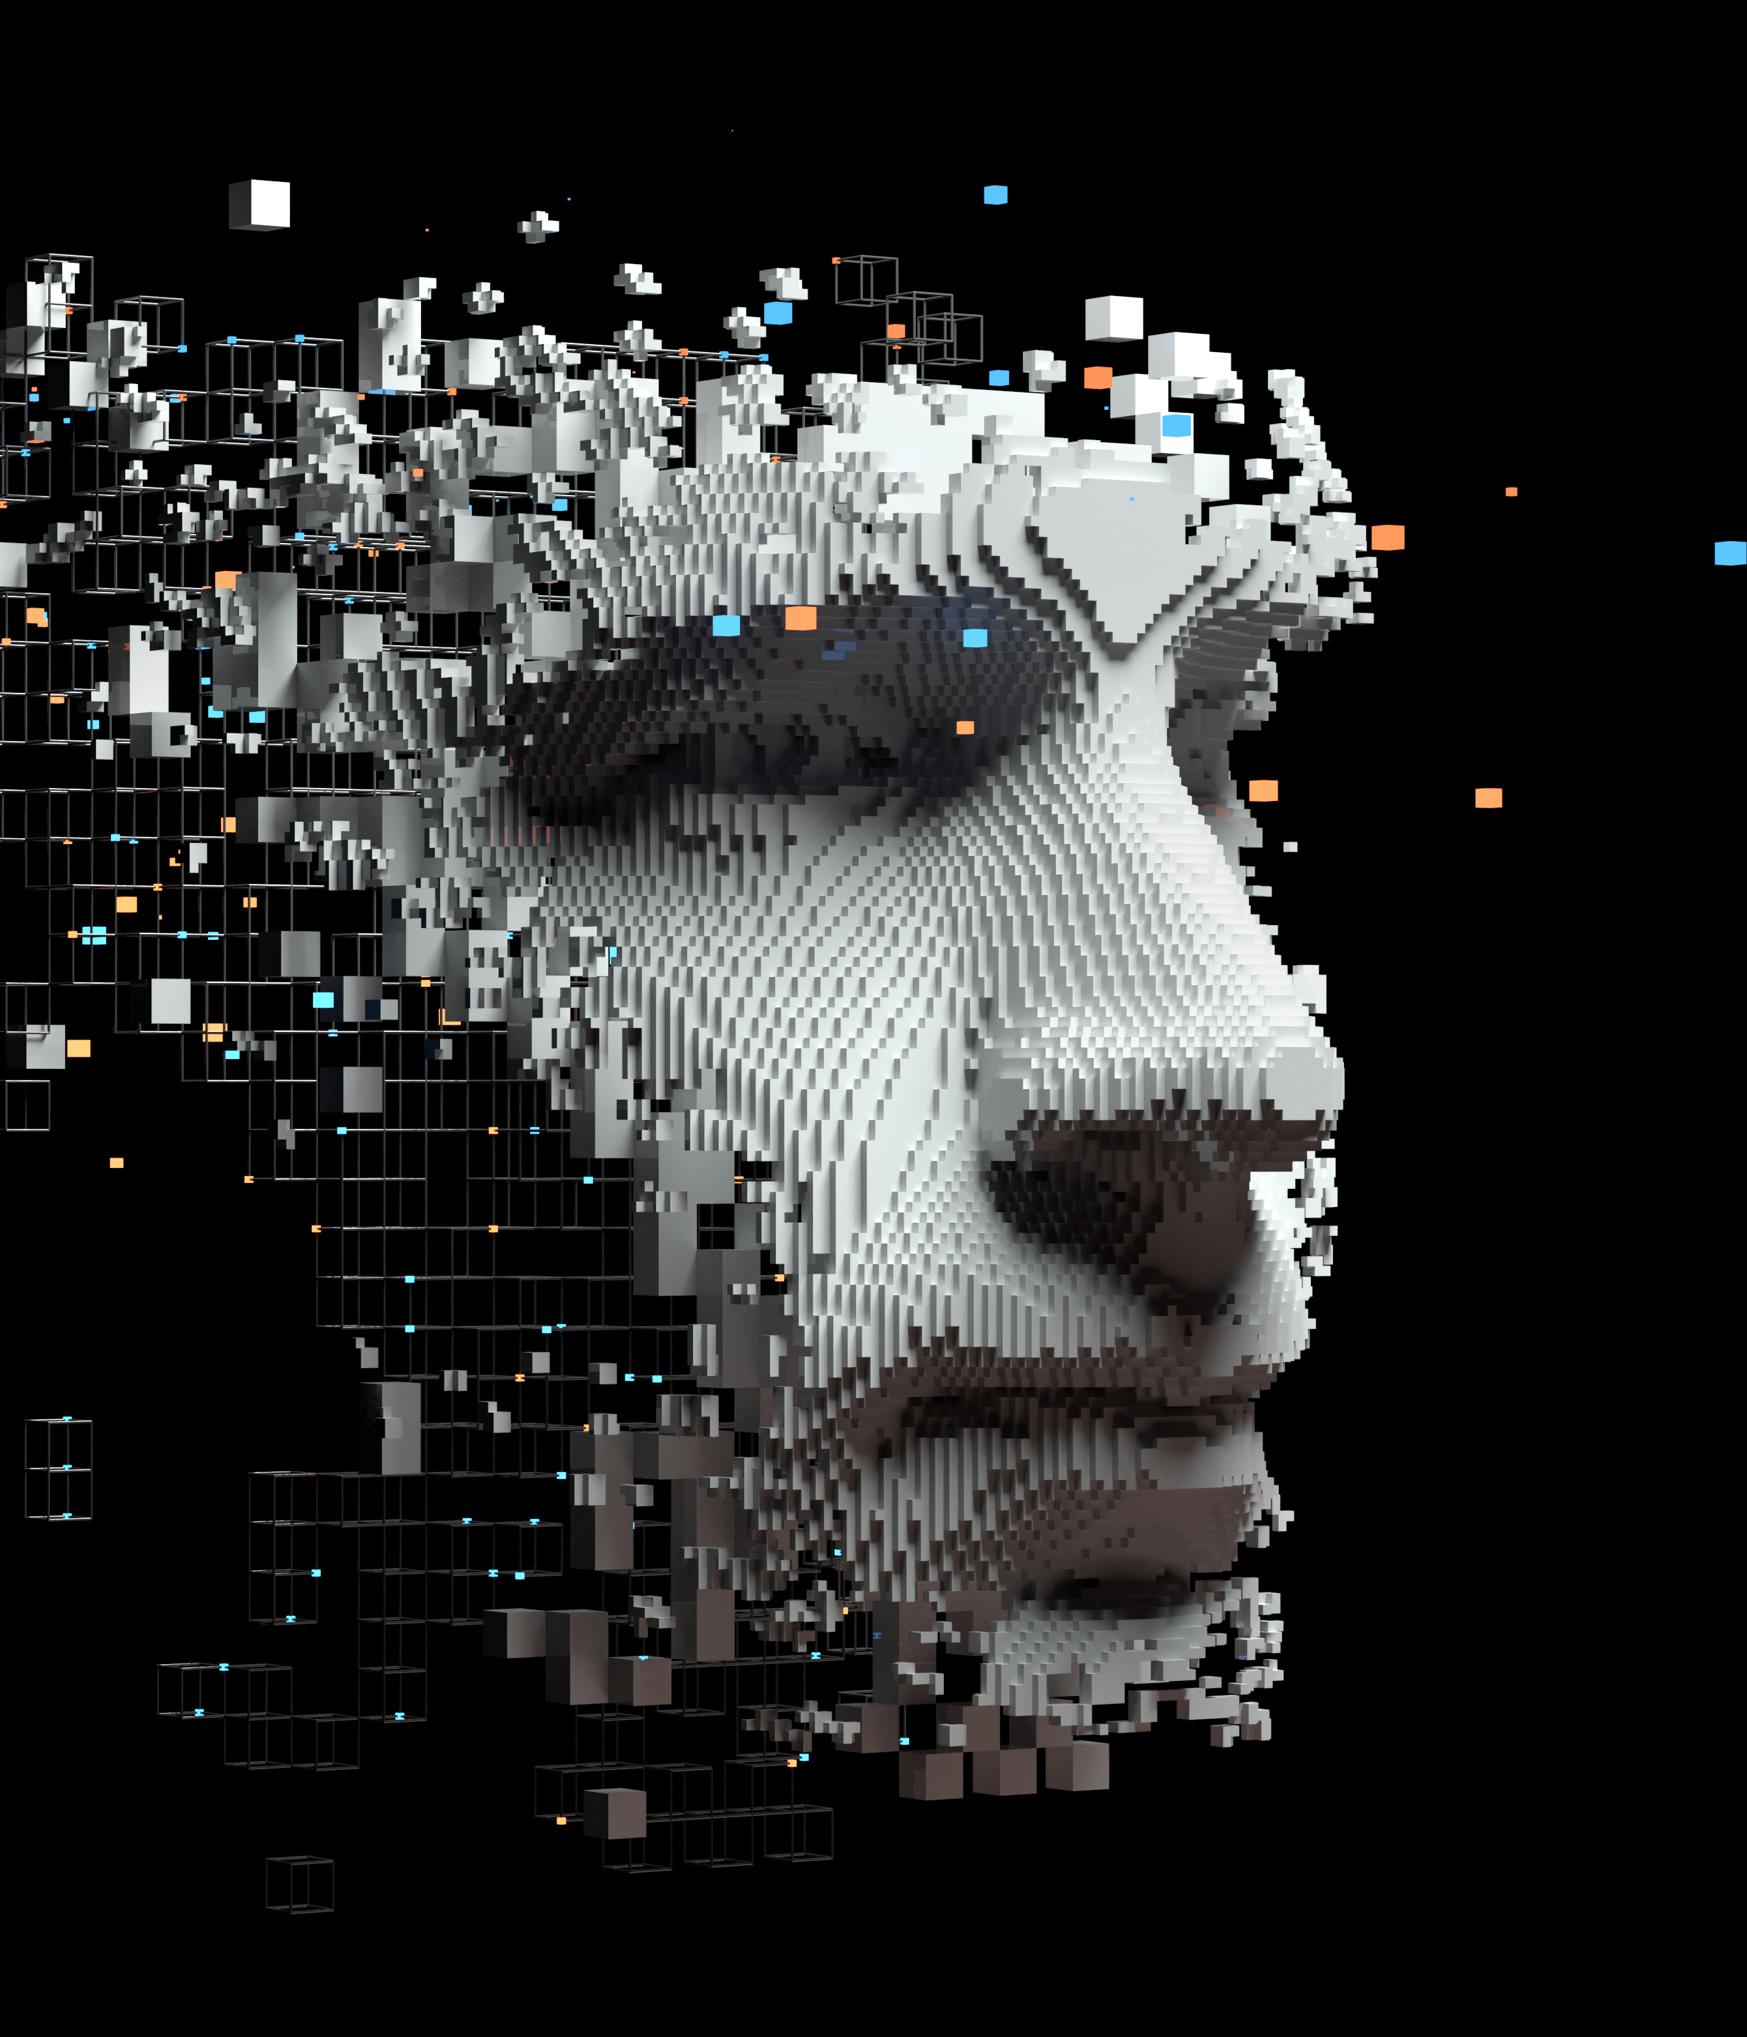
AI and Social media
AI tools make it easy to create fake information.
AI can be used to create fake videos.
AI can also make it harder to tell what is real and what is fiction.
Image courtesy of Microsoft

Slide 8
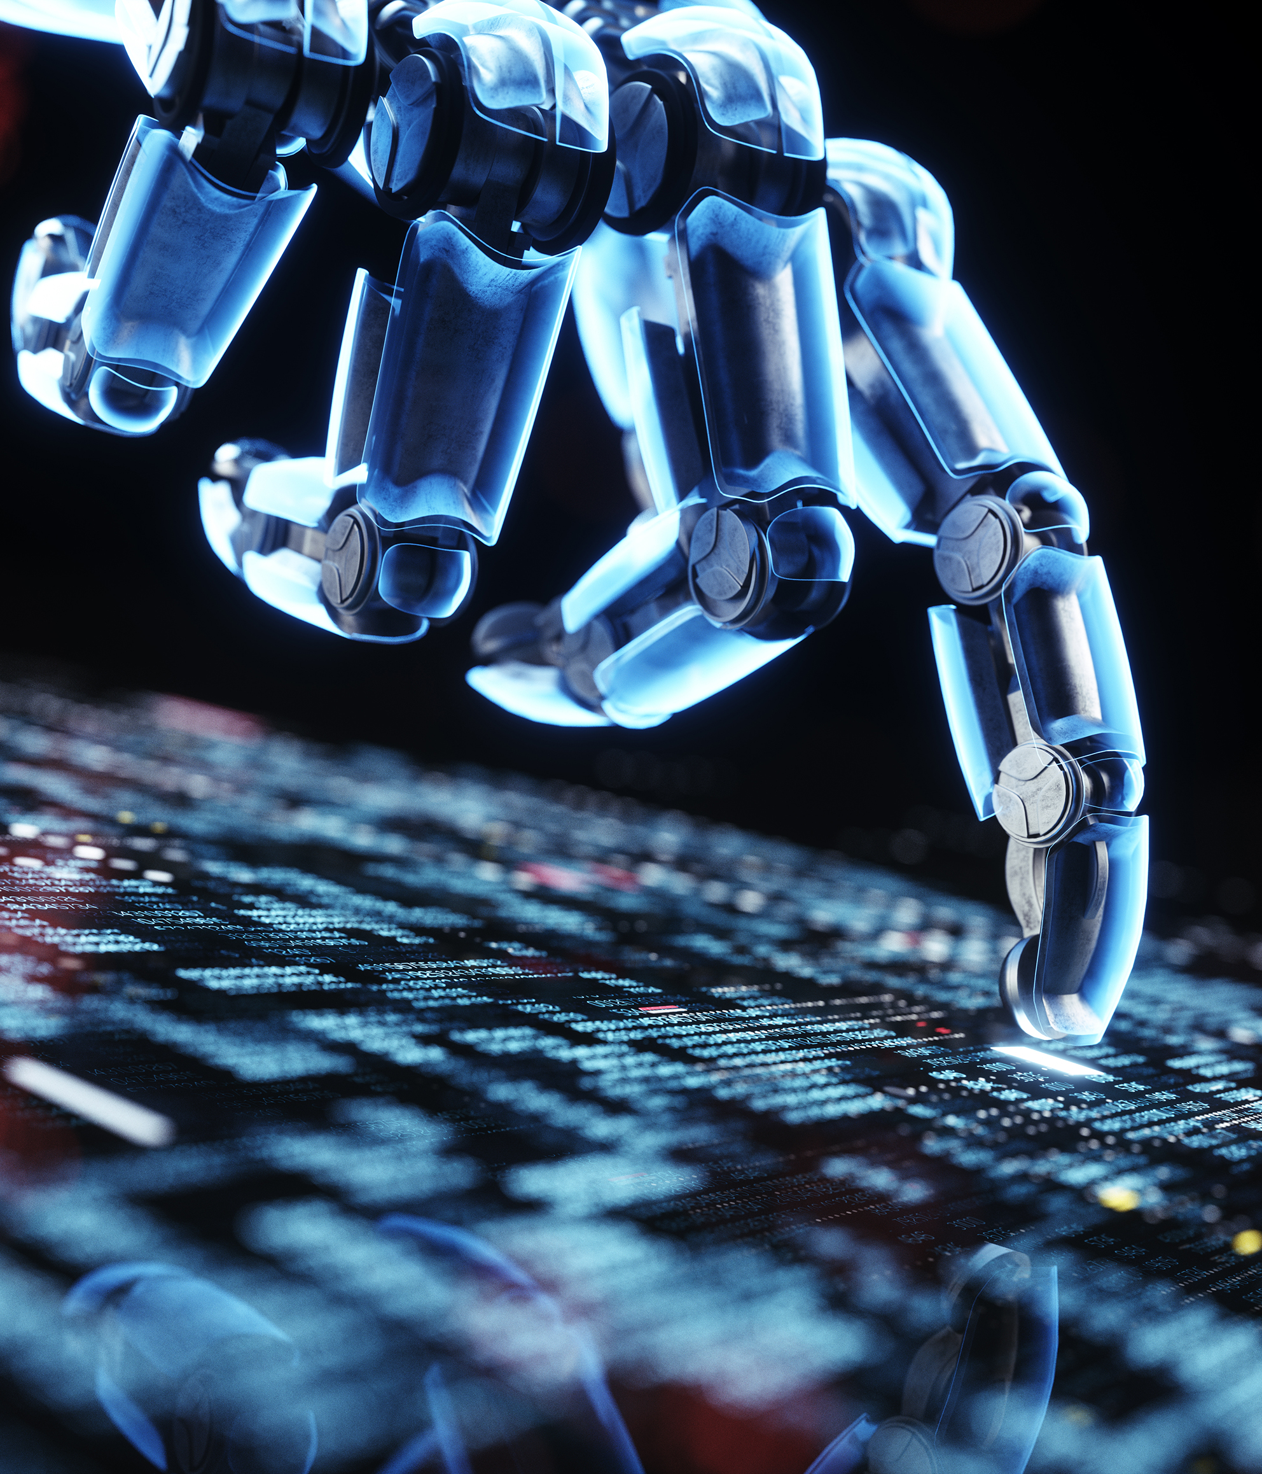
Social media and bots
Bots can be used to inflate a person’s popularity.
Bots can also be used to push scams and harass people.
Bots can also be used to push certain content on these platforms.
Image courtesy of Microsoft

Slide 9
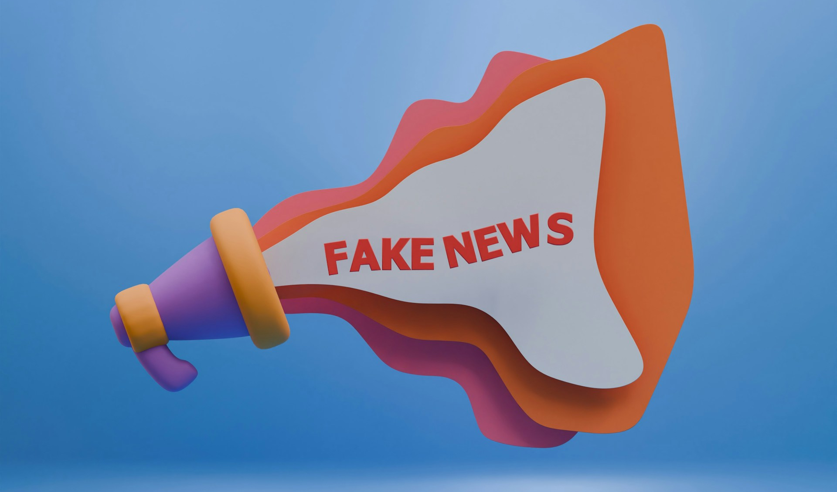
Social media and misinformation
People will post misinformation to gain likes and follows.
Likes and comments act as a reward for these posts.
People will post what ever they want to gain likes.
Image courtesy of Hartono Creative Studio

Slide 10
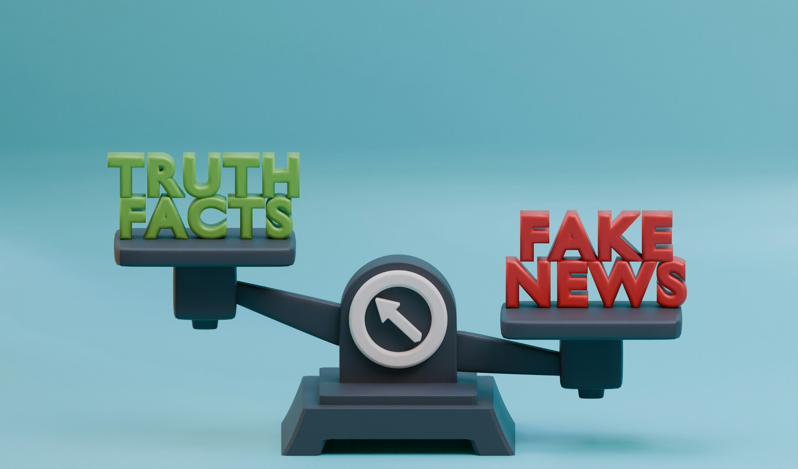
How to Avoid Deception online
You can do your own research to make sure someone is telling the truth.
AI images can be easily spotted due to them making mistakes.
A bot can be spotted by their fake name and their copy and pasted messages.
Image courtesy of Hartono Creative Studio

Slide 11
Social media deception Recap
Social media has become a platform full of deception and misinformation.
People will do anything to gain followers and likes on their posts.
With AI it has gotten harder to tell fiction from reality.

Slide 12
Conclusion
Social media will continue to be a place full of misinformation
As AI continues to improve it will get harder to avoid fake images and videos.
With out proper moderation misinformation and fake images will continue to deceive people.
At the end of the day should social media platforms try to crack down more on bots and misinformation to stop people from being deceived?

Slide 13
References
(2024, October 15). 40% of Americans pretend to be travel influencers on vacation, new survey says. New York Post. Retrieved April 14, 2026, from https://nypost.com/2024/10/15/lifestyle/40-of-americans-try-to-be-travel-influencers-on-vacation-new-survey-says/
Cybersecurity and Infrastructure Security Agency (n.d.). Social Media Bots. CISA. Retrieved April 14, 2026, from https://www.cisa.gov/sites/default/files/publications/social_media_bots_infographic_set_508.pdf
Allen, S. (2023, March 31). How Social Media Rewards Misinformation. Yale Insights. Retrieved April 14, 2026, from https://insights.som.yale.edu/insights/how-social-media-rewards-misinformation
Shin, J. (n.d.). AI and Misinformation. College of Journalism and Communications. Retrieved April 16, 2026, from https://2024.jou.ufl.edu/page/ai-and-misinformation
Russell, A. (2025, November 17). Risks of AI Mirror Social Media. UCDavis. Retrieved April 16, 2026, from https://www.ucdavis.edu/magazine/risks-ai-mirror-social-media
U.S. Government (2023, March 13). Avoiding Scams and Scammers. Federal Deposit Insurance Corporation. Retrieved April 18, 2026, from https://www.fdic.gov/consumer-resource-center/2021-10/avoiding-scams-and-scammers

